Slide 1






Slide 2

“The Goal of Infrastructure Development is to enhance
the standard of living of people and bring happiness”

Slide 3
The objective of infrastructure creation is to deliver
long-term, sustained, & cost-effective services to users.
“Public–Private Collaboration” model enables both the creation of infrastructure & delivery of cost-effective services.

Slide 4
“Infra Advisors” enables exploration, evaluation & investment in infrastructure opportunities in India

Slide 5
Infra Advisors supporting and shaping the infrastructure landscape with its knowledge and expertise built over more than one and half a decade⁺. Established in 2010, delivering advisory services across India and internationally.
Navigating Complexity, Delivering Simplicity

Slide 6
About Infra Advisors

Slide 7




Our Vision
To shape the future of infrastructure by providing exceptional advisory services, fostering strong client relationships, and contributing to a sustainable and prosperous world.
Our Mission
We are on a mission to tirelessly work towards maximizing value addition to stakeholders through innovative, effective and efficient financial solutions.
Our Values
Our zeal keeps propelling us to be the leader in creating value in financial advisory.

Slide 8
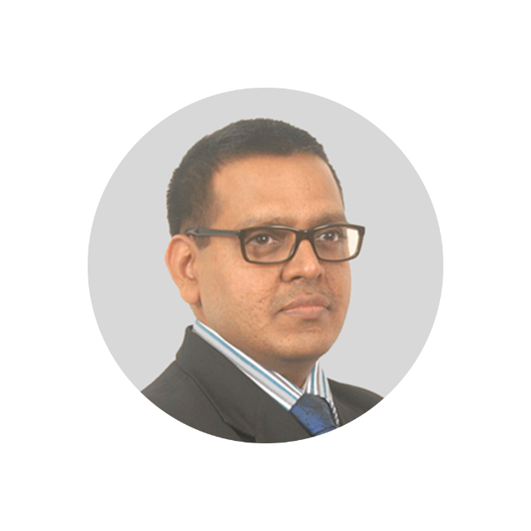



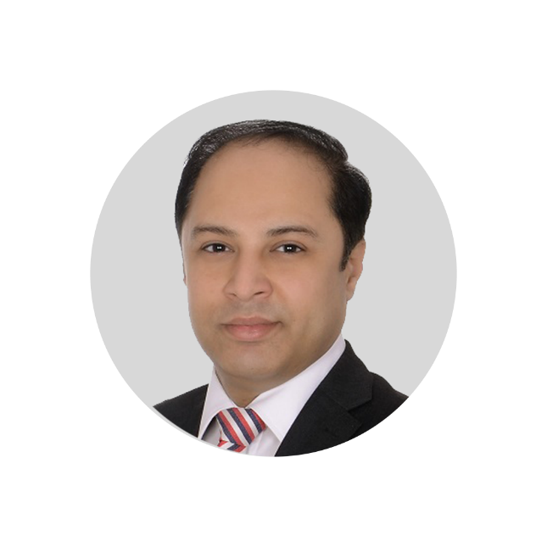
Leadership Team
The Infra Advisors leadership team comprises professionals with extensive experience and expertise in infrastructure project implementation, infrastructure finance, risk and credit management, banking & financial institutions.
Praveen Sethia
Praveen Sethia
C. P. Bhardwaj
CA Sunita Sethia
Anand Surange
Vipin Verma
Founder, Director
Director
Director
Director
Director
Chartered Accountant and Cost Accountant with 30 years of experience in BFSI, Infra Projects and consultancy
Cost Accountant with 30 years of experience in BFSI and consultancy
Chartered Accountant with 30 years of experience in Bid Advisory and Investment Banking
BE and MBA with 30 years of experience in BFSI and consultancy
MBA with 27 years of experience in BFSI and consultancy
"Leadership is the capacity to translate vision into reality" - Warren Bennis

Slide 9



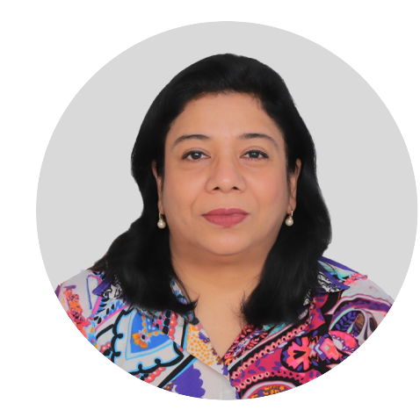

Core Team
Great ideas come from collaboration and diversity of thought. Our core team brings a unique perspective and specialized knowledge that drives innovation and fuels our growth.
Praveen Sethia
Hitesh Goel
Vikram Sethia
CA Aarti Arora
Virender Kataria
Ratna Kumar
Partner
Vice President
Head
President
Vice President
Transaction Advisory
Transaction Advisory
Institutional Advisory Business
Strategic Business Development
Business Development
“People buy into the leader before they buy into the vision” -John C. Maxwell

Slide 10
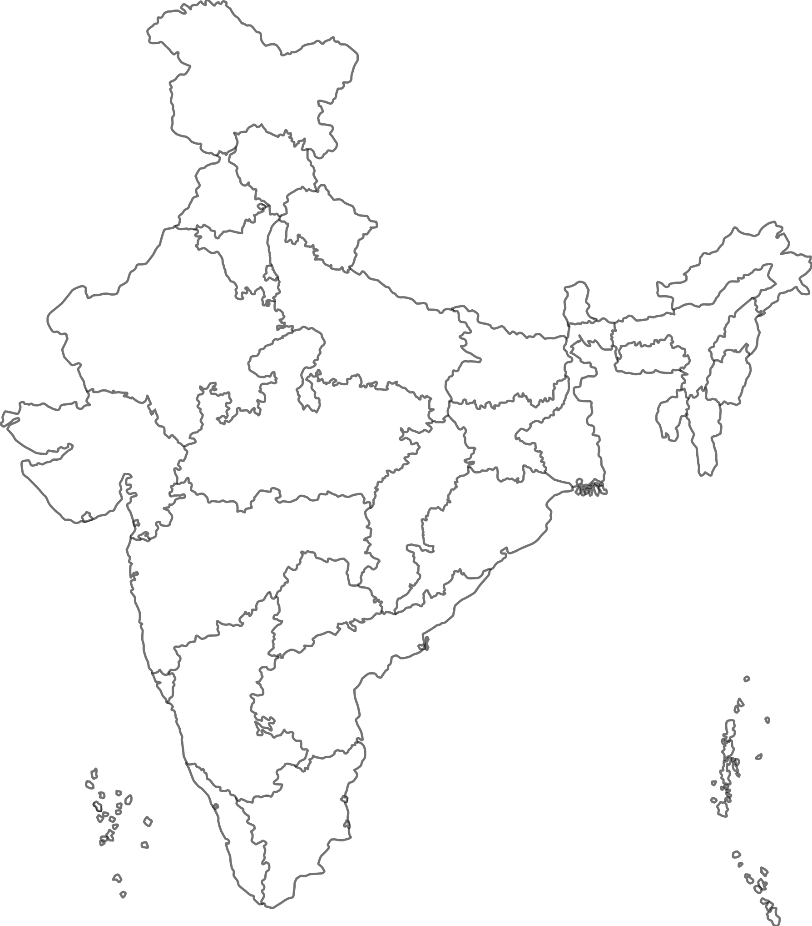

Infra Advisors Geo Footprint
Delhi
Jaipur
Kolkata
Mumbai
Hyderabad

Slide 11
Infra Advisors Business Trajectory
Entered the Urban Transportation Sector.
Commenced
Kolkata Operations.
Achieved a ₹5,000 Crore Debt Syndication Benchmark
Commenced
Delhi
Operations.
2010
2011
2012
2013
2014
2015
2016
2017
Laid the foundation for Infra Advisors in Mumbai.
Began Institutional Advisory for NHAI.
Expanded into Realty &
Health-care Sector Advisory.
Initiated Hybrid Annuity Model advisory for the Road Sector.

Slide 12
Infra Advisors Business Trajectory
Ventured into Multi-Model logistics and Transmission Sector Advisory.
Ranked 1st in Asia Pacific & 6th globally
by Infralogic’s global rankings & Ventured into Renewable
Sector Advisory.
Ventured into M&A Business, focused on PPP Project Assets Divestment.
Ventured into Power Sector Transmission Sector Advisory.
2018
2019
2020
2021
2022
2023
2024
2025
Debt
Syndication for Waste-to-Energy Transaction
with Success.
Pre-Bid Advised for the Largest MDO transaction with Success.
Ranked 2nd Worldwide in Project Finance by Infralogic Global League Tables.
Digi Advisor Launch and 4th position in Asia Pacific by Infralogic’s Global Rankings.

Slide 13
Infra Advisors’s Core Competencies

Slide 14


Infra Advisors Core Competencies
Understanding of the Infrastructure Sector
Public Private Partnership Expert
India’s infrastructure sector is the backbone of
Its economic growth across sectors like transport, energy, urban development, and logistics.
The Leadership Team at Infrastructure Advisors having over three decades of experience, having closely witnessed and contributed to the sector’s evolution.
The Public–Private Partnership (PPP) model is inherently complex, since private investor does not own the underlying public asset, and the investor’s rights and obligations with stringent performance obligations are governed by a contractual framework. obligations provided to ensure uninterrupted service delivery and safeguard national assets.
Experience enables us to understand the complex dynamics of the infrastructure ecosystem, ability to anticipate emerging trends & opportunities.
At Infra Advisors, we are a deep and practical understanding of the nuances of the PPP framework.
Our experience spans the entire project lifecycle from conceptualization, awarding, development, to operations, restructuring during stress situations, and even navigating extreme cases of termination.
Our insights with practical experience,
policy understanding, and market intelligence, empowering clients to make informed, future-ready decisions.

Slide 15
Infra Advisors Core Competencies
Investment Banking and
Debt Market
Mergers & Acquisitions
Infra Advisors brings expertise in helping clients raise
capital for PPP projects by way multiple options like Senior
Debt, Structured and Mezzanine Debt thus optimizing
capital Structure.
Infra Advisors possesses a distinct set of competencies that seamlessly integrate financial, technical, and regulatory expertise to support Mergers and Acquisitions (M&A) Advisory involving Public-Private Partnership (PPP) assets.
With knowledge and understanding of both micro and macroeconomic trends, Infra Advisors actively monitors local market dynamics and the potential impact of global geopolitical events. Thus, ability to understand interest rate movements, credit ratings, credit trends, and overall market sentiment.
Leveraging an extensive network across the infrastructure ecosystem, the firm actively tracks market trends, identifies potential buyers and sellers, and uncovers strategic investment opportunities. Infra Advisors works closely with all stakeholders and expert, including investors, lenders, project authorities, legal counsels, valuers, and tax advisors (both direct and indirect), enabling a comprehensive approach to transaction execution.
Infra Advisors leverages its strong relationships with institutional investors, regulatory authorities, and credit rating agencies to enhance client outcomes.

Slide 16
Infra Advisors’s Services

Slide 17



Infra Advisors Services
Business Advisory
Financial Evaluation
Asset Monetization
Our Business Advisory services are dedicated to guiding clients through the complexities of the infrastructure sector.
We deliver in-depth analysis of market dynamics, assess the
risk-reward landscape, and identify strategic growth opportunities—empowering clients to make informed,
forward-looking decisions.
Our Financial Modeling services focus on evaluating project- and transaction-specific opportunities with precision and insight.
We deliver decision-ready,
robust, tailored solutions
covering contractual frameworks, tax implications, accounting standards, market trends, commercial viability, bankability, and bid competitiveness.
Holding infrastructure assets
till maturity often proves counterproductive for several reasons.
In alignment with the terms of the concession agreement, divestment
is a beneficial approach.
Monetization services enable higher value realization, faster turnaround, and the optimization of transaction structures to ensure maximum returns.

Slide 18
Infra Advisors Services | Investment Banking
Facilitate efficient capital raising tailored to project timelines and requirements.
Secure competitive financing at the lowest possible cost.
Attract leading domestic senior project lenders.
Strategic Capital Raising
Our IB services are designed to
Optimal Financing Structures
We specialize in structuring
Non-recourse and limited-recourse financing to de-risk the developer.
Financing solutions aligned with agreement terms and risk allocation.
Capital structures that are bankable.
Built-in Flexibility
Our IB advisory solutions offer
Provisions for refinancing at later date with favorable exit terms.
Mechanisms to unlock free capital or equity during operation period.
Enhanced cash flow management at promoter level.
Supporting developers from project inception to financial close.
Navigating complex regulatory and commercial negotiations.
Enhancing financial resilience and long-term project viability.
End-to-End Support
We act as a strategic IB partner

Slide 19

Infra Advisors Services | Digi Advisors
Digi Advisors offers digital products designed to simplify and enhance the financial modeling process for PPP Road-HAM infrastructure projects. These products ensure efficiency and accuracy throughout the pre-bid process.
Pre pack Financial Model aligning with CA Terms
Flexible Input Options & Automated Calculations
Allows users to enter cost estimates, explore different Bid Project Costs, and test various scenarios such as loan repayment, DSRA, and EPC phasing.
Instantly generates accurate IRR and cash flow analyses, streamlining the process and ensuring efficiency.
Decision-Support Tools
Facilitates assessment of multiple financial strategies, helping users identify
the most optimal bid structure.
Features robust security measures to ensure that user inputs and results
are fully protected.
Data Integrity & Security

Slide 20
Infra Advisors’s Sectoral Coverage

Slide 21


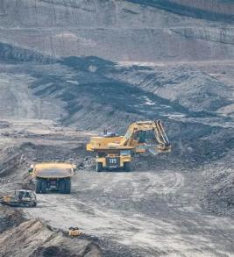

Infra Advisors Sectors Coverage
Roads
Renewable Energy
Mining
Commercial & MDO
Transmission

Slide 22



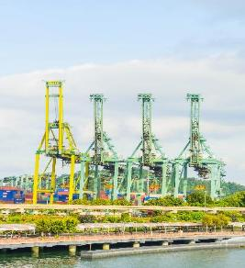
Infra Advisors Sectors Coverage
ATF Pipeline
LPG Pipeline
Multi Modal
Logistic Park
Natural Gas Pipeline

Slide 23


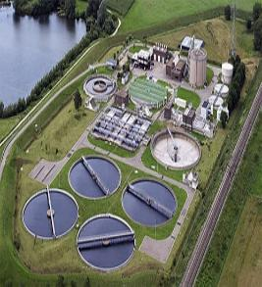

Infra Advisors Sectors Coverage
Gati Shakti
Cargo Terminals
Smart Meters
Waste to Energy
Waste Water STP

Slide 24


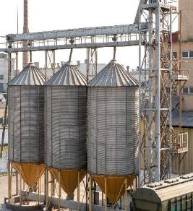

Infra Advisors Sectors Coverage
EVs
Rope Way
Affordable Housing
Food Grain Silos

Slide 25
Infra Advisors’s Client Portfolio

Slide 26











Infra Advisors Institutional Clientele

Slide 27




























Private Sector Clientele

Slide 28




























Private Sector Clientele

Slide 29




























Private Sector Clientele

Slide 30




























Private Sector Clientele

Slide 31














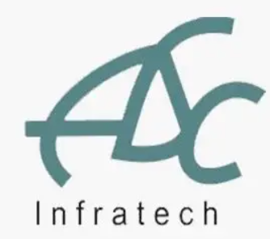
Private Sector Clientele
Rajendra Singh Bhamboo Infra Private Limited
SBE
Infrastructure
Devendra Construction Co
Sarala Project Works Private Limited
Many More…

Slide 32
With over a decade of experience and deep insights across various facets of infrastructure, “Infra Advisors” as
“PPP Expert” & “Finance Expert”
empowers client to venture into the infrastructure sector

Slide 33


Thank You
write to us at
contact@infragroup.co.in

